Slide 1

Lecture 13: Refine Your Project with Peer Evaluation
Dr. Tsung-Wei Huang
Department of Electrical and Computer Engineering
University of Utah, Salt Lake City, UT
Notes:
Hello everyone, today we are going to help you go through the team forming process.

Slide 2
Project Website v2
Due today (3/12) 11:59 PM
Many of you already provide feedback to others
Most are harsh
No worry, this is typical; the most difficult thing in the world is to convince people to “buy” your idea
This is why it is important to listen to other people’s opinions and use them to refine your idea from time to time
Successful start-up companies often don’t use the original initial ideas
Refine your project idea based on peer comments
Keep in mind, idea itself doesn’t work!
It takes a community for a product to be successful
For example, why do you use iphone ☺ ? If my idea is to just make the phone run faster, its market value is not convincing.
Update your timetable for project activities in v2

Slide 3

Defend Your Project Idea
Now, you need to convince potential users
What is wrong with your comment?
What is correct with your comment?
Why should you change your mind to buy me idea?

Slide 4
Refine Your Project Idea
We have opened 10 breakout rooms
Zoom: https://utah.zoom.us/j/2468214418
1-9 are assigned for teams from last week
Thesis track students are in room 10
Each group work together to do the following:
Review all comments given to your project: https://github.com/tsung-wei-huang/cs3992/issues
Discuss comments and compile three responses:
What’s wrong with your comment
What’s correct with your comment
Why should you change your mind to buy my idea?
Post your discussion as a single reply to the issue page
No need to have a single reply for each comment
Most comments are similar, so combine everything together

Slide 5
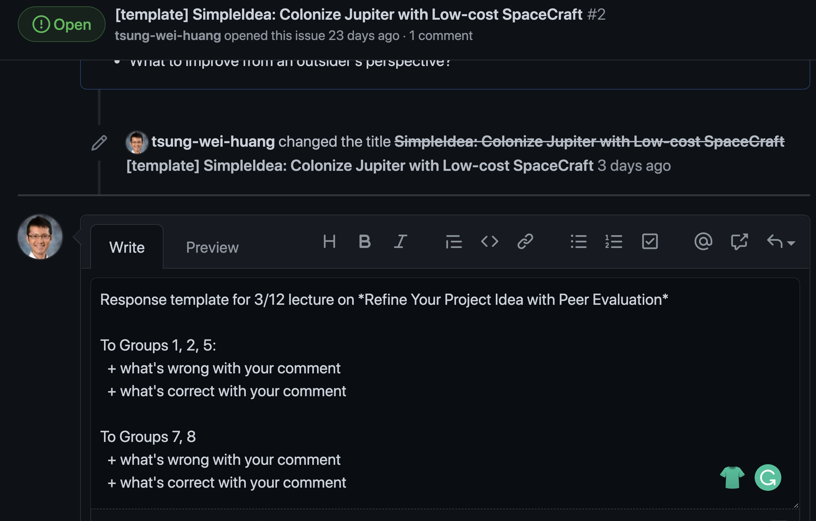
Refine Your Project Idea (cont’d)
https://github.com/tsung-wei-huang/cs3992/issues
Each breakout room selects one person to share the screen to work together on responses!

